Slide 1
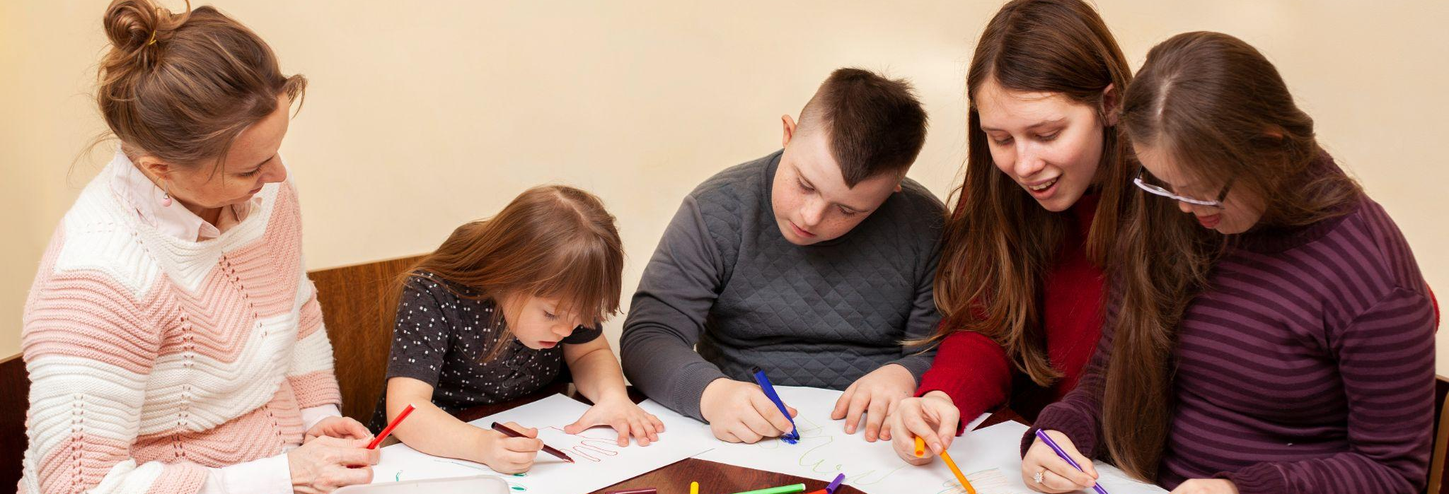
Handicapped Children Daycare Educational Center
Here is where your presentation begins

Slide 2
Contents of this template
You can delete this slide when you’re done editing the presentation
Fonts | To view this template correctly in PowerPoint, download and install the fonts we used
Used and alternative resources | An assortment of graphic resources that are suitable for use in this presentation
Thanks slide | You must keep it so that proper credits for our design are given
Colors | All the colors used in this presentation
Icons and infographic resources | These can be used in the template, and their size and color can be edited
Editable presentation theme | You can edit the master slides easily. For more info, click here
For more info: SLIDESGO | BLOG | FAQs
You can visit our sister projects: FREEPIK | FLATICON | STORYSET | WEPIK | VIDEVO

Slide 3
Table of contents
01
02
03
04
Our teaching method
Our academic areas
You can describe the topic of the section here
You can describe the topic of the section here
areas
The school’s teachers
Enrollment process
You can describe the topic of the section here
You can describe the topic of the section here

Slide 4
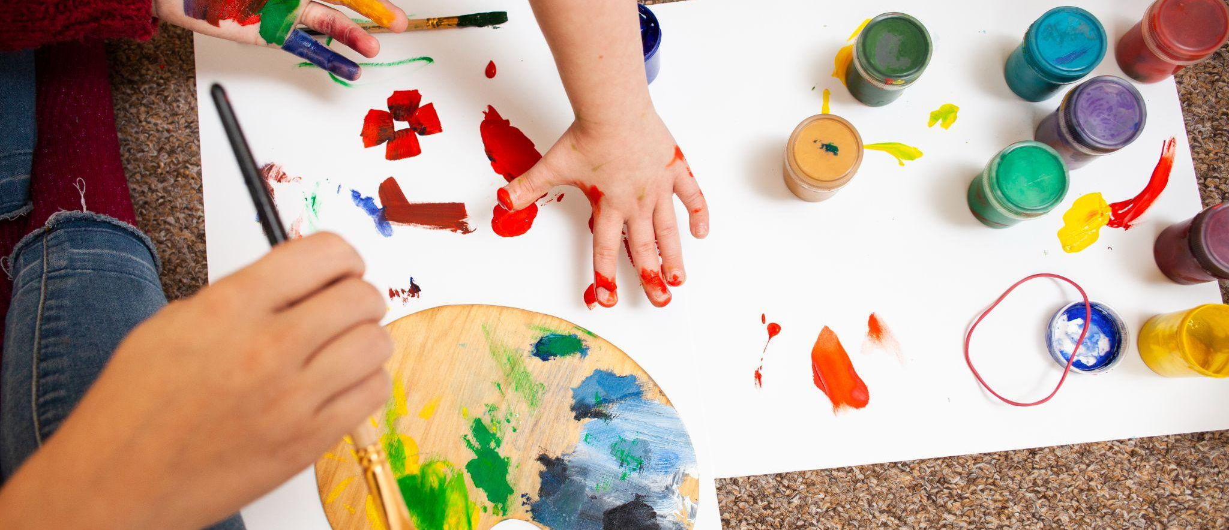
Introduction
Mercury is the closest planet to the Sun and the smallest one in the entire Solar System. This planet's name has nothing to do with the liquid metal, since Mercury was named after the Roman messenger god. Its temperatures aren't as terribly hot as that planet's
Mercury takes a little more than 58 days to complete its rotation, so try to imagine how long days must be there! Since the temperatures are so extreme, albeit not as extreme as on Venus, Mercury has been deemed to be non-habitable for humans

Slide 5
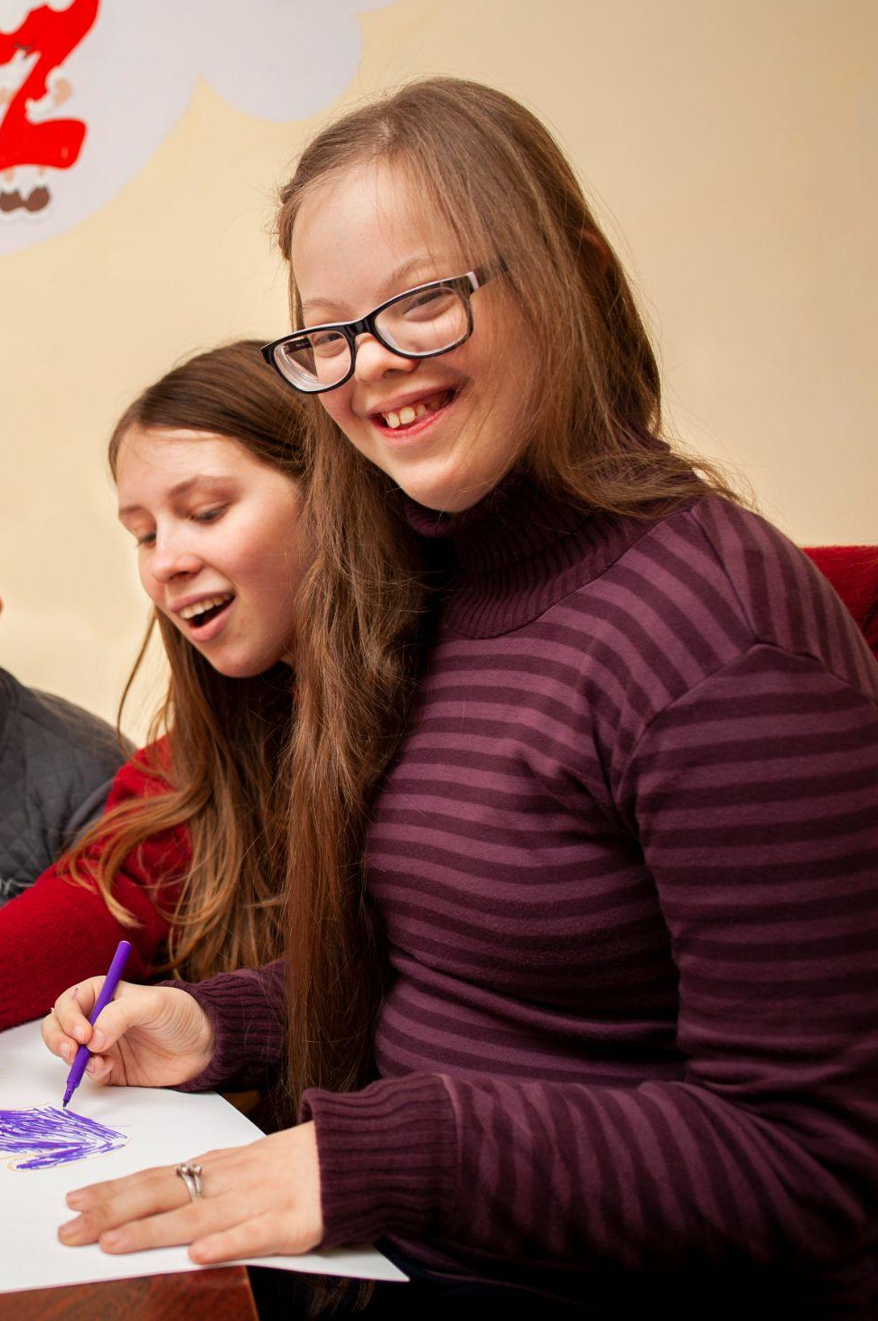
—Someone Famous
“This is a quote, words full of wisdom that someone important said and can make the reader get inspired”

Slide 6
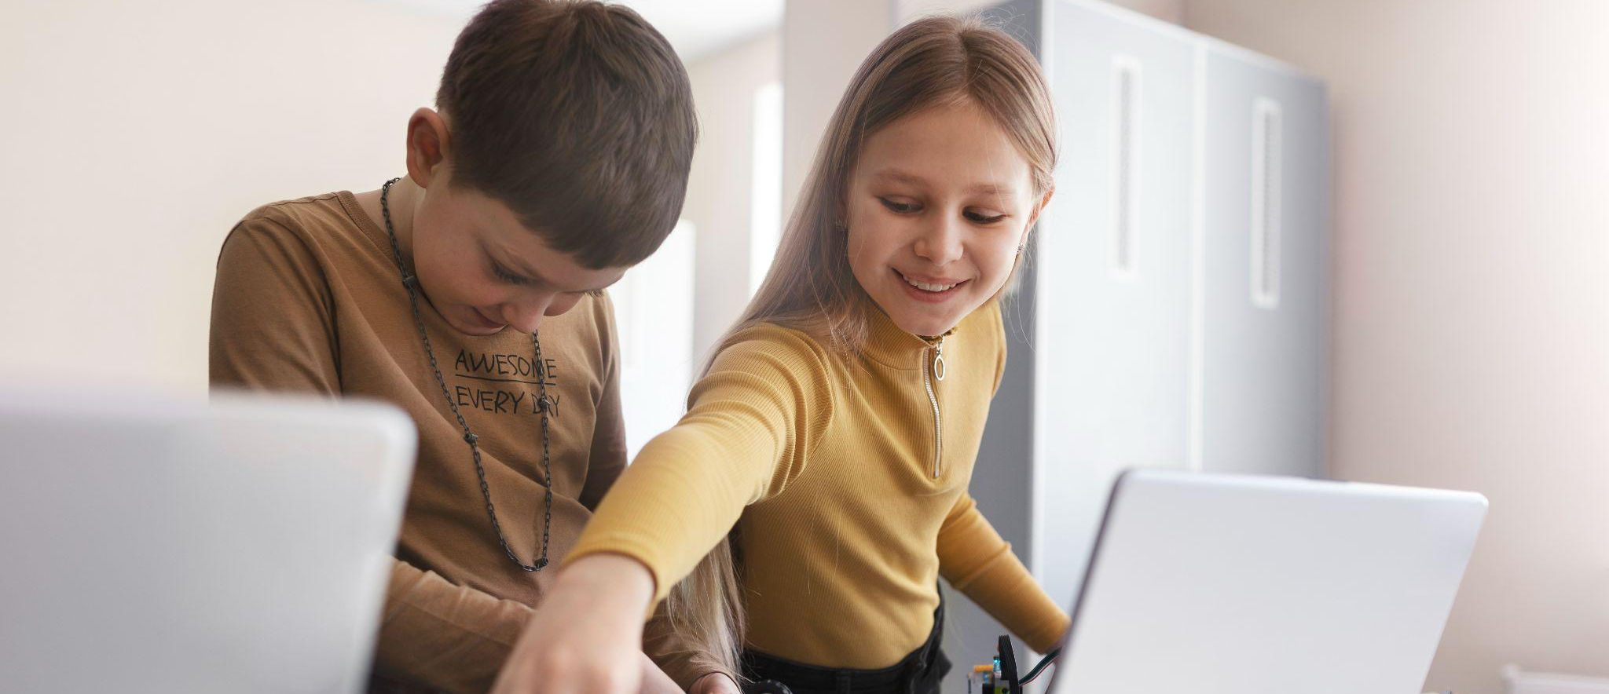
Our teaching method
01
You can enter a subtitle here if you need it

Slide 7
Our teaching method
Methods
Activities
Goals
Feedback
Assessment
Mercury is a very small planet
Saturn is a gas giant with rings
Jupiter was named after a Roman god
Neptune is an ice giant and big
Mercury was named after a god
Saturn has several beautiful rings
Jupiter was named after a Roman god

Slide 8
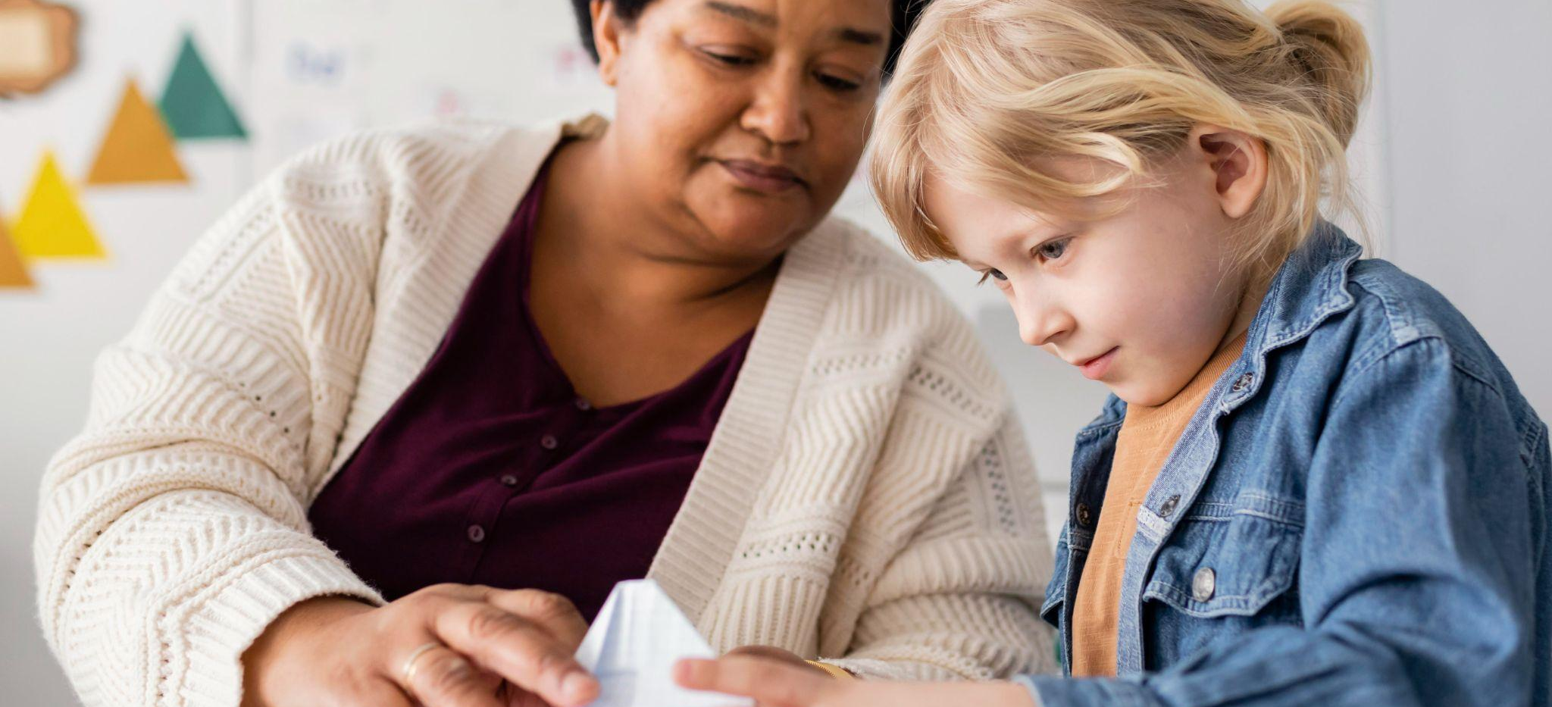
What sets us apart?
Mercury
Venus
Mars
Mercury is the closest planet to the Sun and a very small object
Venus has a beautiful name and is the second planet from the Sun
Despite being red, Mars is actually a cold place. It’s full of iron oxide dust

Slide 9
The curriculum
Introduction
Features
Venus has a beautiful name and is the second planet from the Sun. It’s terribly hot, even hotter than Mercury, and its atmosphere is extremely poisonous
3/5
Mars: it’s actually a cold planet. It's full of iron oxide dust
4/5
Advantages
Earth: it’s the only planet known to harbor life in Solar System
Mercury is a small planet
Venus has a nice name
Mars is a very cold planet
Jupiter is a gas giant and big
Neptune is far away from Earth
2/5
Saturn: it’s composed mostly of hydrogen and helium

Slide 10
Our academic areas
Mars
Venus
Neptune
Mars is actually a very cold planet
Venus is the second planet from the Sun
Neptune is the farthest planet from the Sun
Mercury
Saturn
Jupiter
Mercury is the closest planet to the Sun
Saturn is a gas giant with several rings
Jupiter is the biggest planet of them all

Slide 11
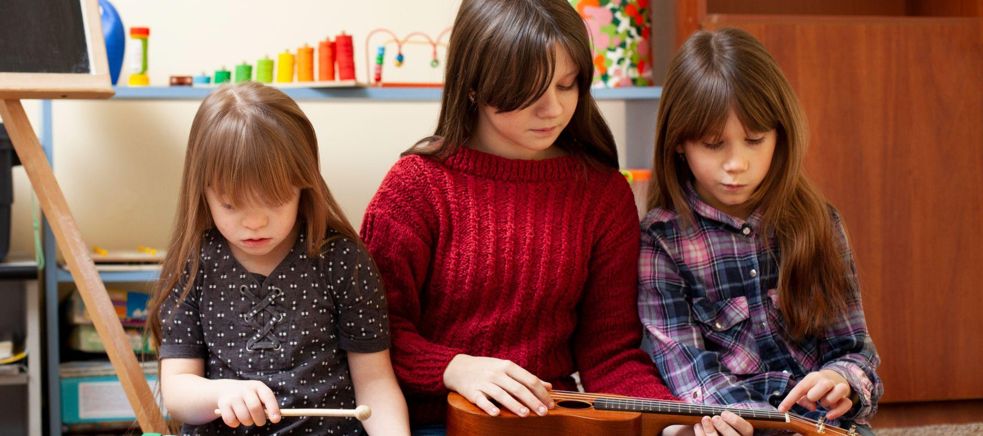
Our mission and vision
Mission
Mercury is the closest planet to the Sun and the smallest one in the Solar System—it’s only a bit larger than the Moon
Vision
Venus has a beautiful name and is the second planet from the Sun. It’s hot and has a poisonous atmosphere

Slide 12
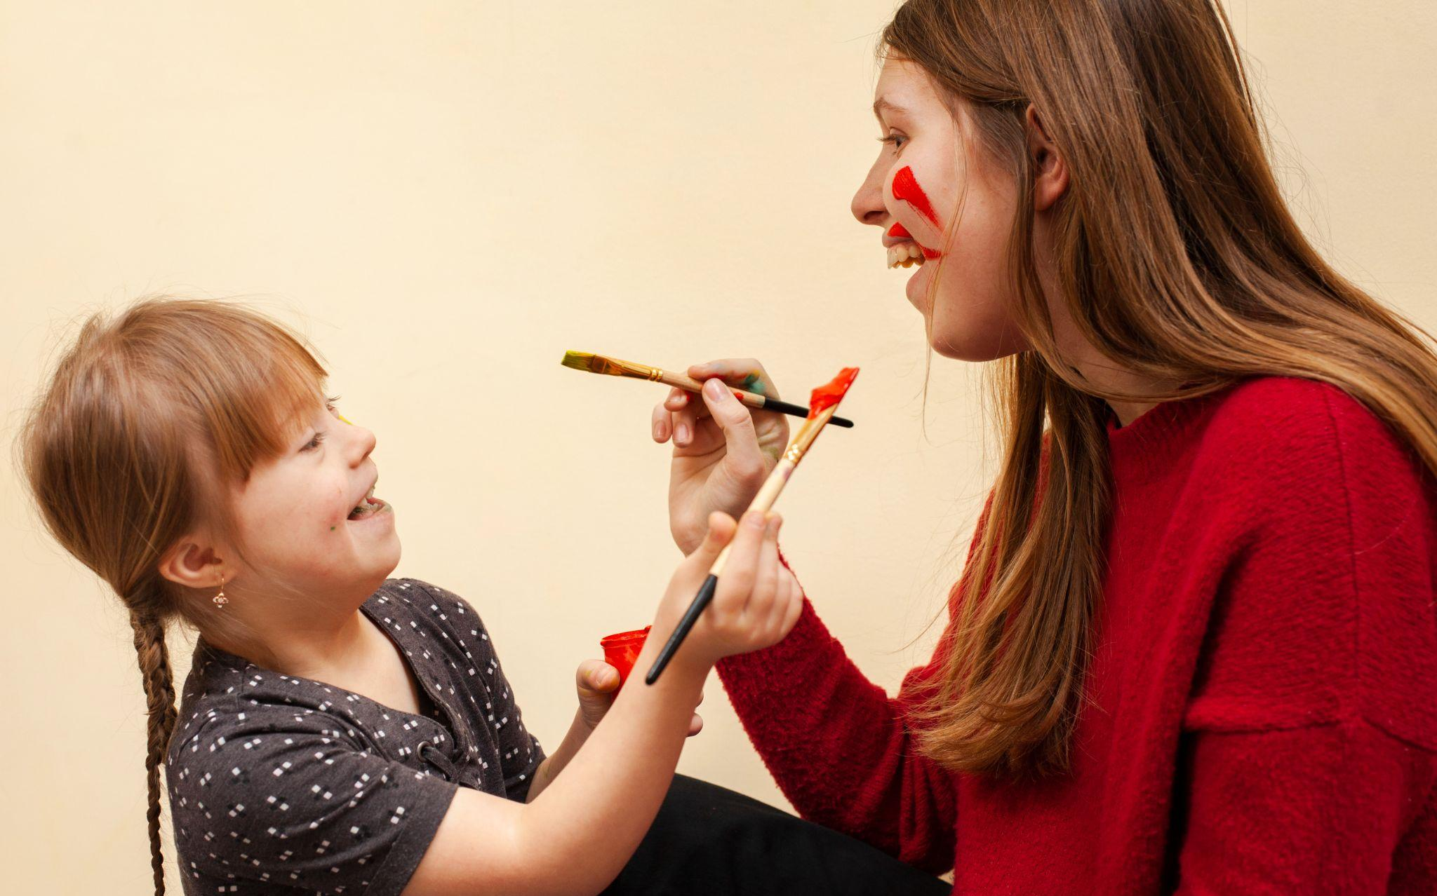
Our values
Mars
Neptune
Mars is actually a very cold planet
Neptune is very far from the Sun
Jupiter
Saturn
Jupiter is the biggest planet of them all
Saturn is a gas giant and has several rings

Slide 13
Our success
50%
25%
75%
Mercury
Venus
Mars
Mercury is the closest planet to the Sun and a very small object
Venus has a beautiful name and is the second planet from the Sun
Despite being red, Mars is actually a cold place. It’s full of iron oxide dust

Slide 14
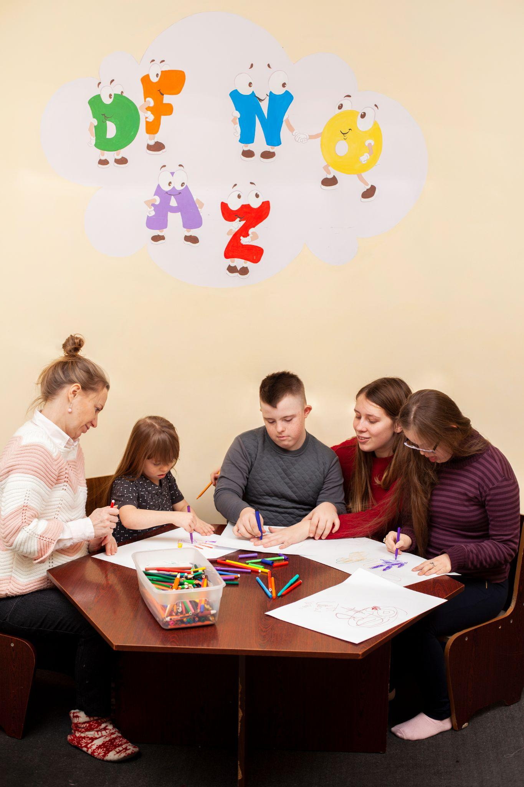
98,300,000
Big numbers catch your audience’s attention

Slide 15
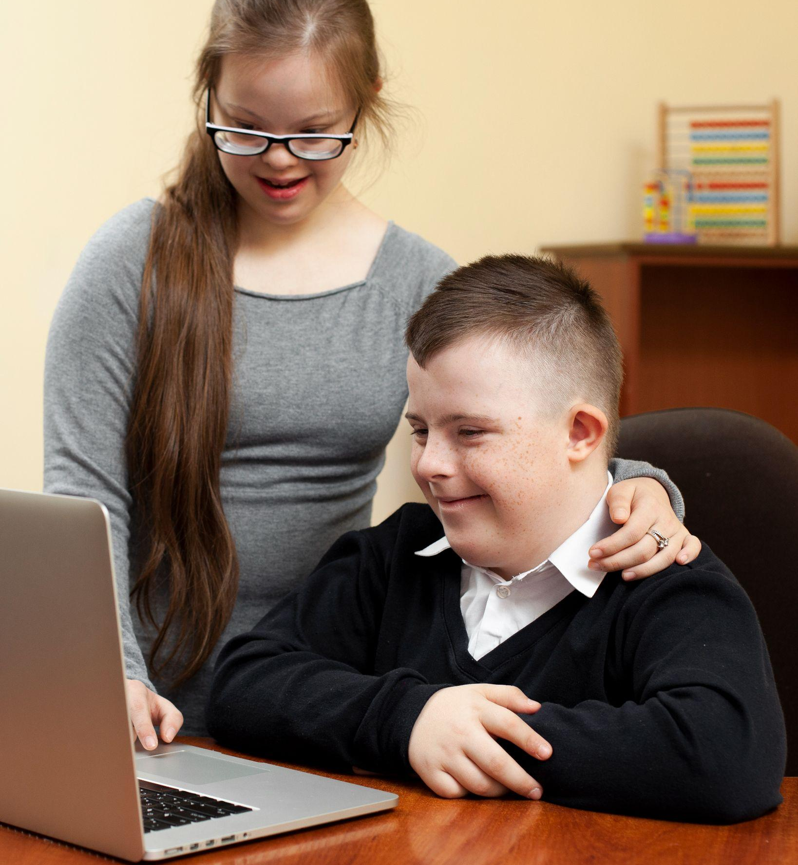
Awesome words

Slide 16
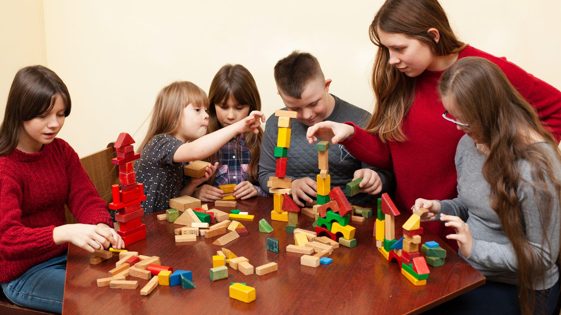
A picture is worth a thousand words

Slide 17
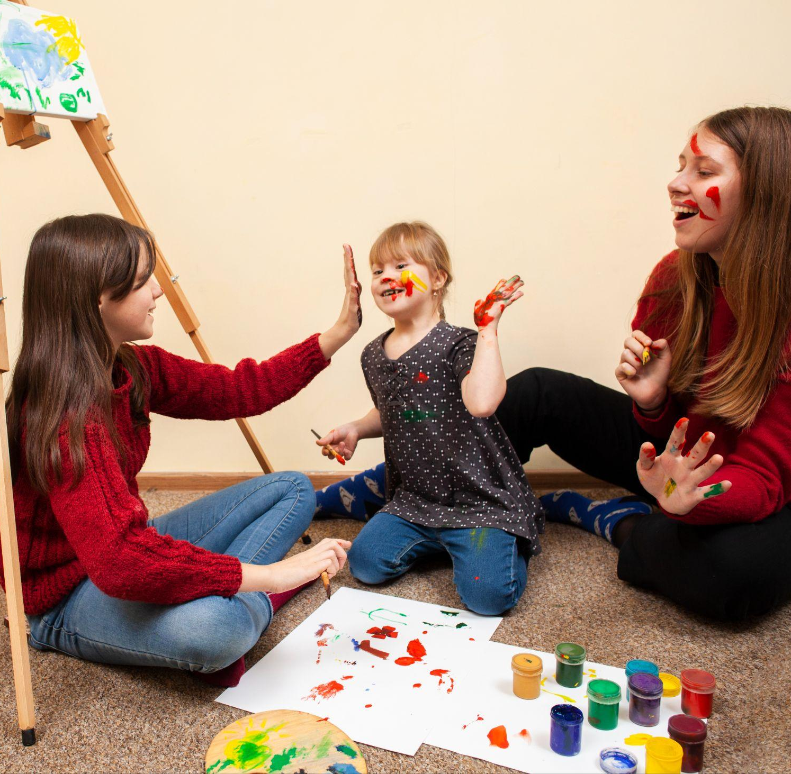
A picture always reinforces
the concept
Images reveal large amounts of data, so remember: use an image instead of a long text. Your audience will appreciate it

Slide 18
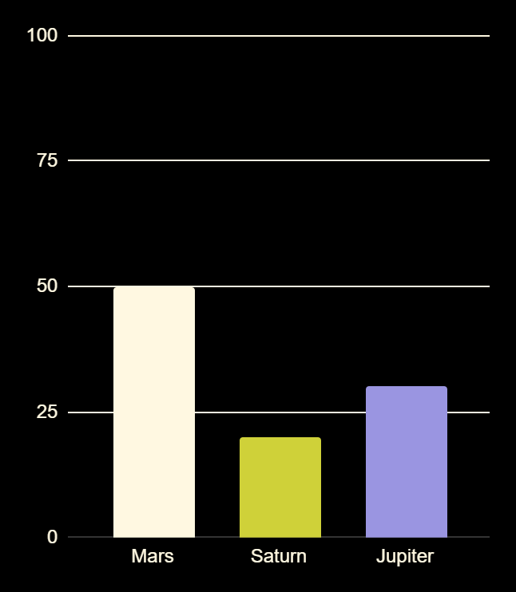
Statistics
Mars
Total | Concept
50% | Mars is red
20% | Saturn has rings
30% | Jupiter is a gas giant
Mars is actually a very cold planet
Saturn
Saturn is a gas giant with several rings
Jupiter
Jupiter is the biggest planet of them all
Follow the link in the graph to modify its data and then paste the new one here. For more info, click here

Slide 19
This is a map
Mars
Mars is actually a very cold planet
Jupiter
Jupiter is the biggest planet of them all
Saturn
Saturn is a gas giant and has several rings

